Slide 1




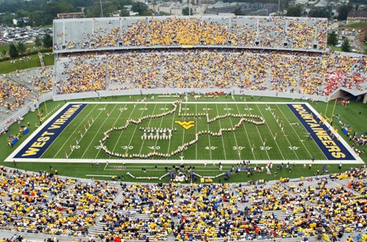
Marching Band
Home
Gallery
Band Camp
Sign Up
News
<
>
Marching Band
Have you ever had to sudden urge to make a ton of noise? Well, now you can make some music out of it! We will teach you how to play and perform with an instrument. The range of instruments you can choose from is very large. Here in Marching Band there is a place for everyone, so why not join today? You will make life-long friends and be able to contribute to something quite magnificent!

Slide 2
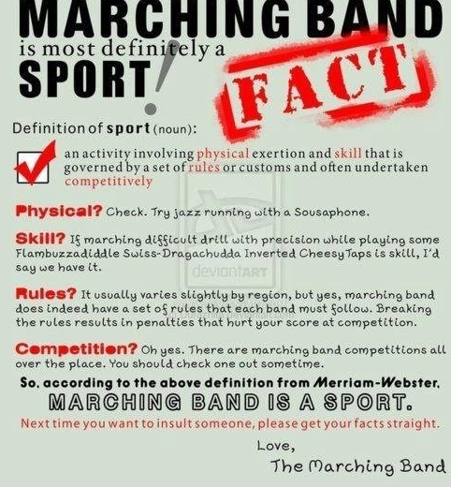


Marching Band as a sport?
There is a ton of hard work that goes into marching band! You must be able to blow enough air into your instrument to make a noise, memorize your notes, remember your position, all the while moving on beat at the cadence of your drum major. There is a lot more to Marching Band than one may realize! If you’re up for a challenge then you will definitely fit right in! If you’re up for competition, there are plenty of Band Tournaments you will be able to compete in where you will go against other bands in your class!
Privacy Policy
FAQ
Join now
www.marchingband.com
Connect

Slide 3
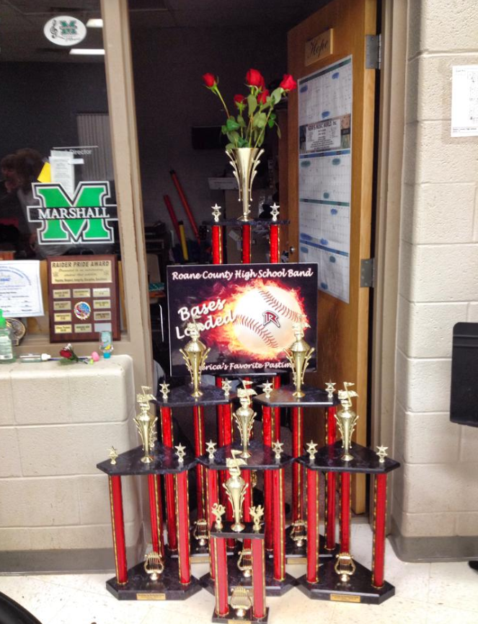
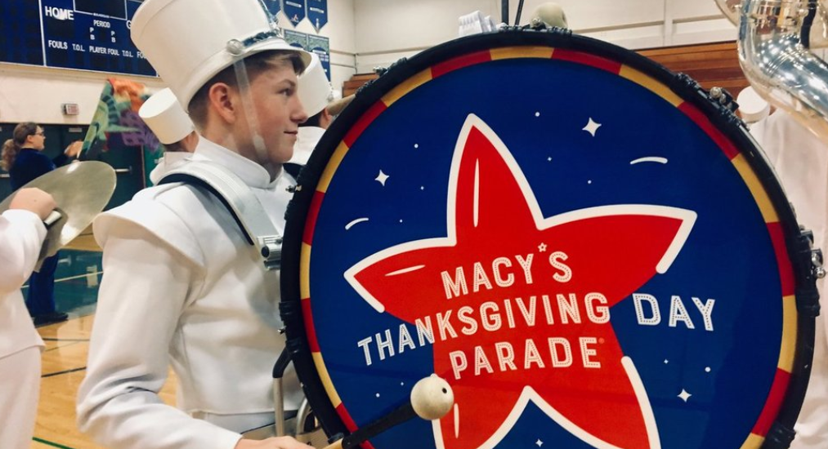
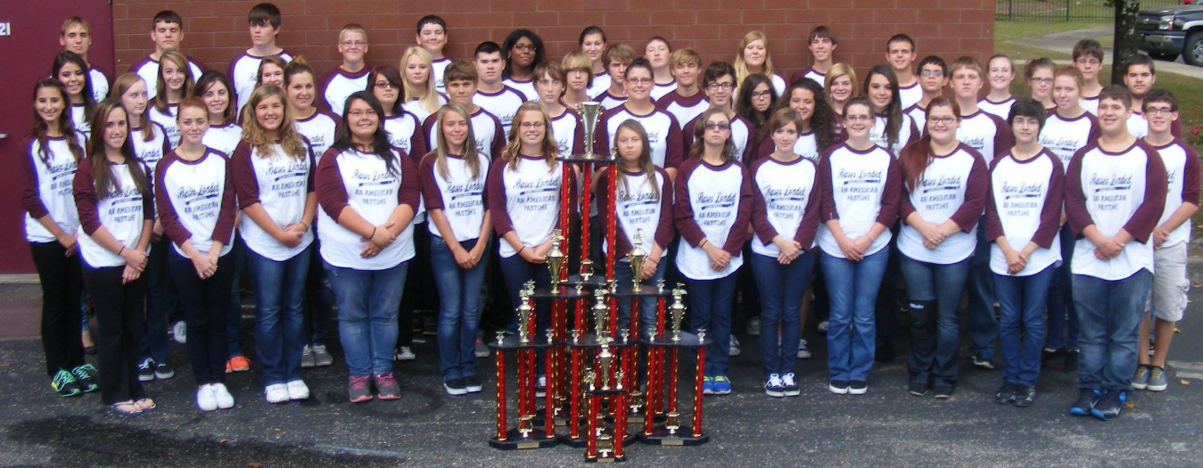
Marching Band
Home
Home
Gallery
Band Camp
Sign Up
News
Grand Champion
Macy’s Day Parade
Group Photo

Slide 4
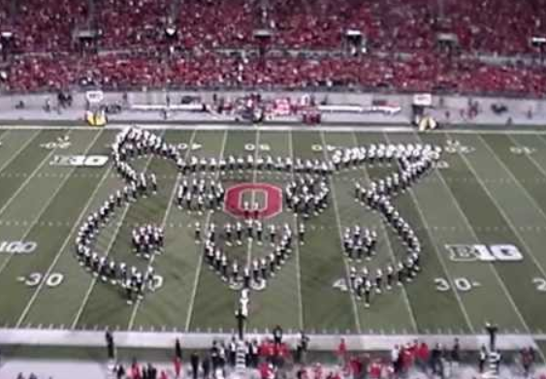
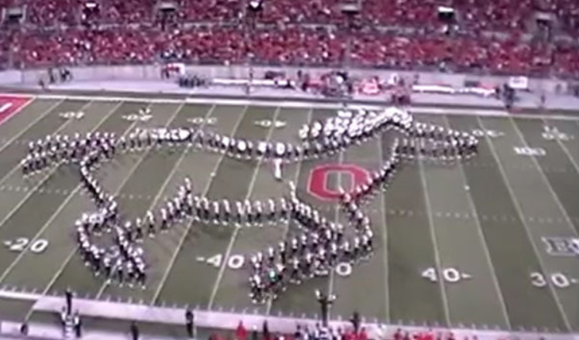
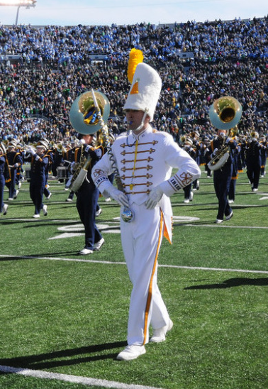
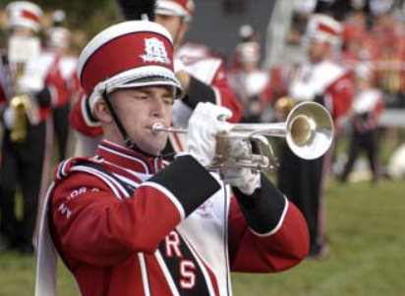
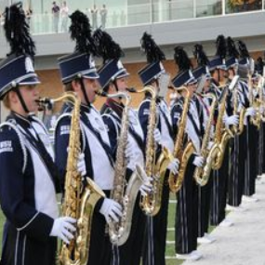
Pikachu
Moving Horse
Trumpet Player
Drum Major
Saxophone Players
Privacy Policy
FAQ
Join now
www.marchingband.com
Connect

Slide 5
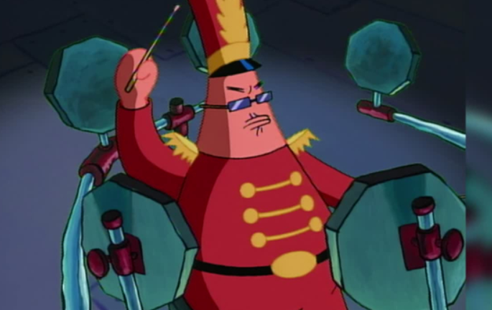
Marching Band
Home
Home
Gallery
Band Camp
Sign Up
News
Band Camp!

Slide 6

What happens at band camp stays at band camp…
Privacy Policy
FAQ
Join now
www.marchingband.com
Connect

Slide 7
Marching Band
Home
Home
Gallery
Band Camp
Sign Up
News
Moving Horse
The Ohio State Buckeyes manage to pull off a magnificent show piece for their marching band design! A horse that actually moves while it is on the field. It starts from the beginning of the field and walks all the way down the end. The amount of effort and speed to have an object move is multiplied since instead of making random shapes, they must now be quick enough to move in a speed that gives it life like features. Too slow and they will make it look less realistic. Truly a great piece by the band!

Slide 8
To be asked to play at the Macy’s Thanksgiving Parade is a true honor. The Macy’s Day Parade has been part of our countries pastime since 1928, and since then it has been a yearly tradition around Thanksgiving. Musicians, floats, marching bands, and loads of people walk down the streets of New York giving the millions of viewers a show to be proud of! It’s no wonder so many people tune into the Macy’s Day parade each Thanksgiving!
Privacy Policy
FAQ
Join now
www.marchingband.com
Connect

Slide 9


Marching Band
Home
Home
Gallery
Band Camp
Sign Up
News
Marching Band Sign Up
If you are considering joining the Marching Band, please complete the below form. All fields are required unless otherwise noted as optional. You will be sent information about auditions and band camp.

Slide 10
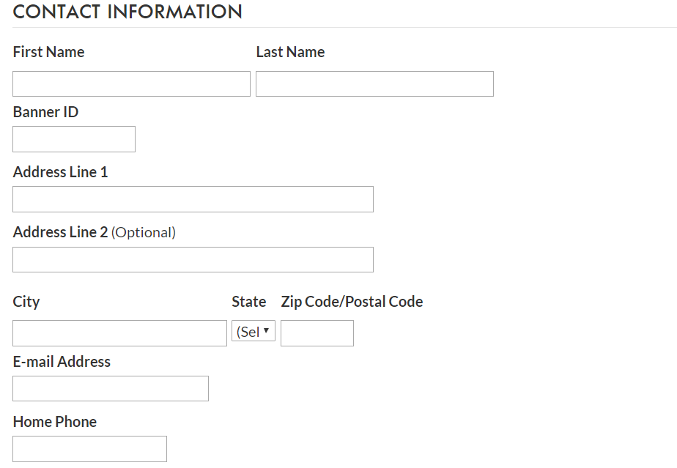

Privacy Policy
FAQ
Join now
www.marchingband.com
Connect

Slide 11
Functionality

Slide 12
Marching Band
Home
Gallery
Band Camp
Sign Up
News
x
Nav bar color changes
<
>
Carousel
Marching Band
Have you ever had to sudden urge to make a ton of noise? Well, now you can make some music out of it! We will teach you how to play and perform with an instrument. The range of instruments you can choose from is very large. Here in Marching Band there is a place for everyone, so why not join today? You will make life-long friends and be able to contribute to something quite magnificent!

Slide 13
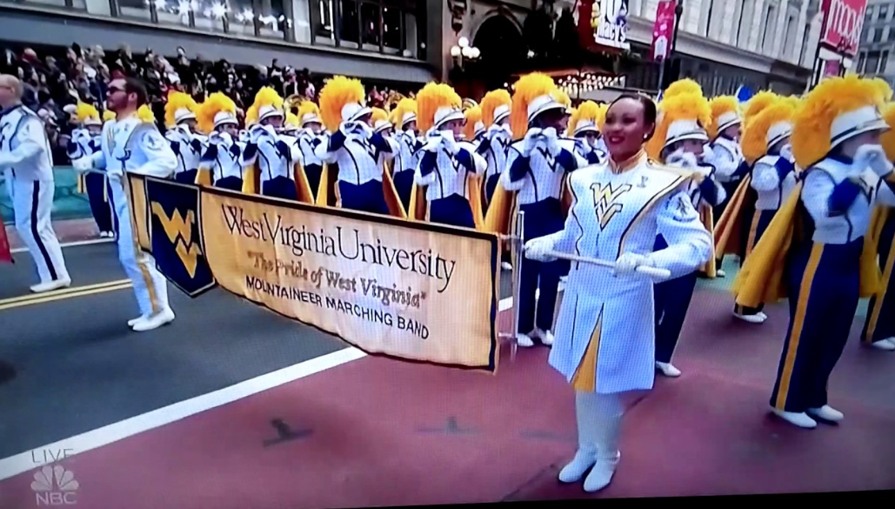
Marching Band
Home
Gallery
Band Camp
Sign Up
News
x
Nav bar color changes
<
<
>
>
Carousel
Marching Band
Have you ever had to sudden urge to make a ton of noise? Well, now you can make some music out of it! We will teach you how to play and perform with an instrument. The range of instruments you can choose from is very large. Here in Marching Band there is a place for everyone, so why not join today? You will make life-long friends and be able to contribute to something quite magnificent!

Slide 14
Marching Band
Home
Home
Gallery
Band Camp
Sign Up
News
Grand Champion
Macy’s Day Parade
Group Photo

Slide 15
Marching Band
Home
Home
Gallery
Band Camp
Sign Up
News
Band Camp!

Slide 16
Marching Band
Home
Home
Gallery
Band Camp
Sign Up
News
Will include a gif of the horse moving
Moving Horse
The Ohio State Buckeyes manage to pull off a magnificent show piece for their marching band design! A horse that actually moves while it is on the field. It starts from the beginning of the field and walks all the way down the end. The amount of effort and speed to have an object move is multiplied since instead of making random shapes, they must now be quick enough to move in a speed that gives it life like features. Too slow and they will make it look less realistic. Truly a great piece by the band!

Slide 17
Marching Band
Home
Home
Gallery
Band Camp
Sign Up
News
Marching Band Sign Up
If you are considering joining the Marching Band, please complete the below form. All fields are required unless otherwise noted as optional. You will be sent information about auditions and band camp.

Slide 18
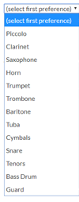
Includes a drop down

Slide 19
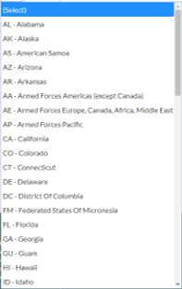
Sign Up
Privacy Policy
FAQ
Join now
www.marchingband.com
Connect

